Slide 1

WHY YOU SHOULD WORK IN UPPLABS
For tech professionals eager to work in one of the best software development companies

Slide 2
WITH UPPLABS
TEAM UPP
We have won the trust by delivering more than 150 SUCCESSFUL PROJECTS for the clients from almost all over the world.
Our team provides FULL-CYCLE WEB AND MOBILE APPLICATIONS development that facilitates your business with top-notch user-friendly solutions.
We love INNOVATIONS and use only UP-TO-DATE TECHNOLOGIES and approaches to suit your needs.
You concentrate only on your WORK, and we TAKE CARE OF THE ENVIRONMENT.

Slide 3



IN UPPLABS
CAREER
 |  | to vote
FLEXIBLE WORK SCHEDULE | EVERYONE HAS A VOICE | ROOM TO GROW
We value efficiency, not the strict schedule. You can choose your working mode and hours. Stay in your comfort zone | As a flat company, we share responsibility and achievements. Every member of our team has the opinion and the right to vote | We consider every opportunity and encourage you to be open to growth and expand your horizons

Slide 4
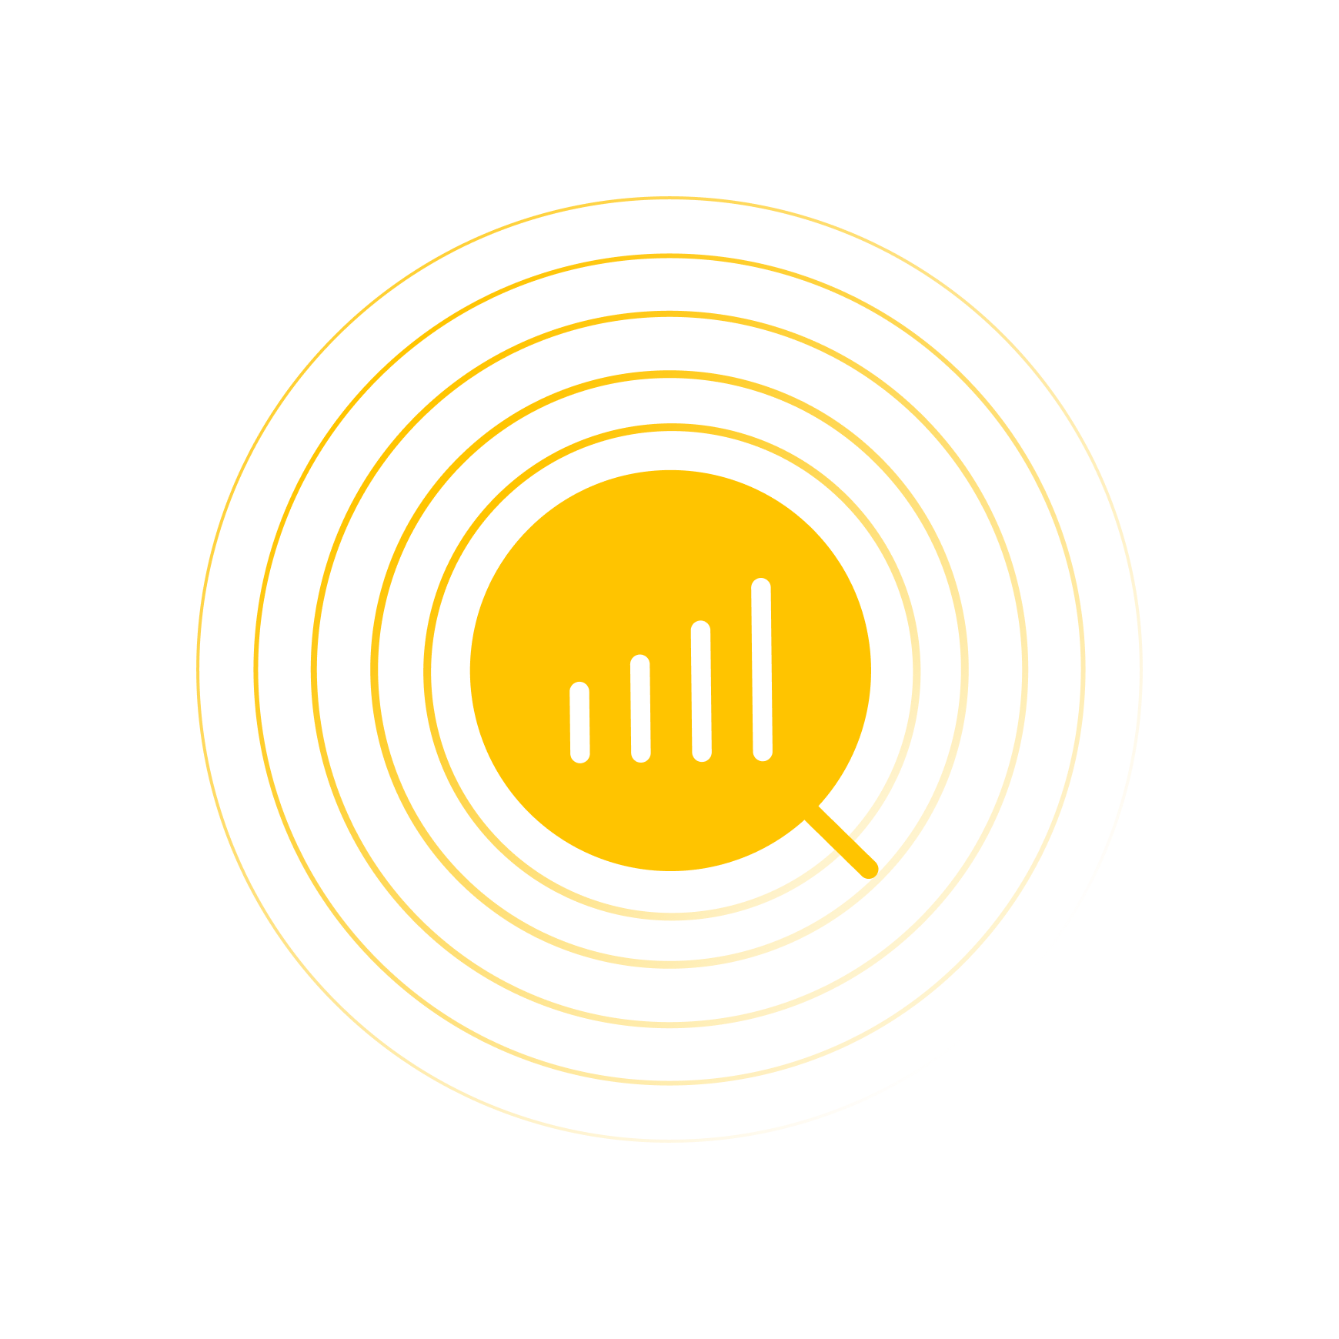


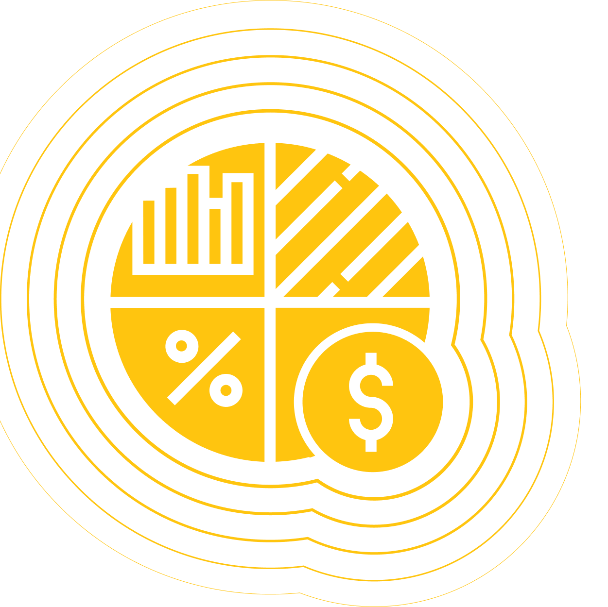

ABOUT UPPLABS
FACTS
WITH 85% OF SENIOR DEVELOPMENT STAFF
WE ARE FLAT COMPANY
150+ SUCCESSFUL PROJECTS | 1/3 CLIENTS RETURN TO UPPLABS TO DEVELOP THE NEXT PROJECT | 76% OF EMPLOYEES RECOMMEND US TO THEIR FRIENDS

Slide 5

& UPPLABS
NIKA TECH FAMILY
UppLabs is a part of Nika Tech Family
Nika Tech Family unites 10+ fast-growing innovative companies with global distribution
Smart investments help achieve the quickest growth and scaling, business optimization and innovations
Holding involves the highest authority mentors from our business niche to maximize the results

Slide 6

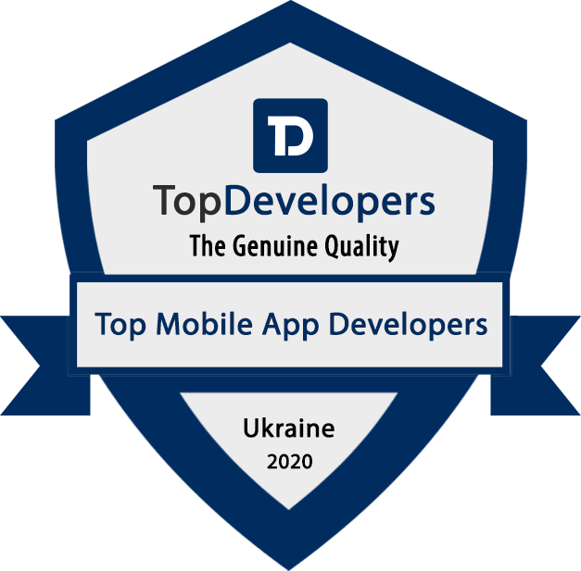

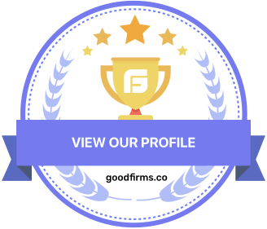
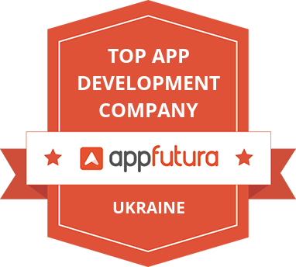


RECOGNITION
Top 10 App Development Companies in Ukraine
Top Web Development Companies on Clutch
Top Software Development Companies in Ukraine
Top Development Companies
Top App Development Companies in Kyiv
Top 10 Software Development Companies in Ukraine
Top 10 Mobile App Development Companies in Ukraine

Slide 7
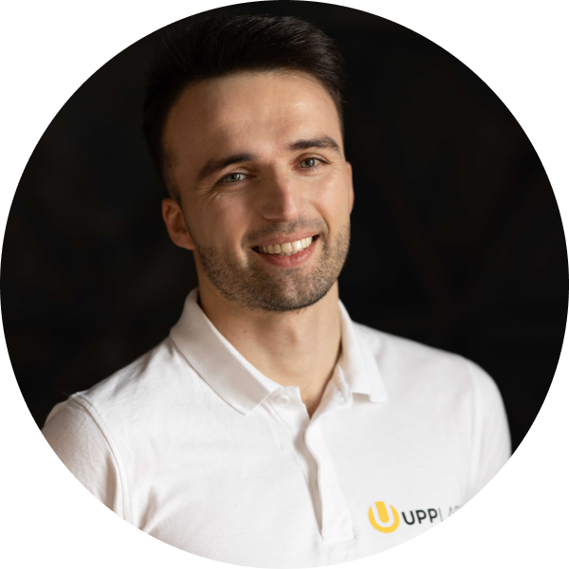

FROM OUR FOUNDER
LEARN BEST PRACTICES
CEO AND FOUNDER Vitaliy Dyachenko – among TOP 50 tech visionaries in the US according to InterCon | INCLUDED IN ‘40 under 40’ innovators list by MobileAppDaily | MENTOR at Facebook Developer Circle and Maya Startup Hub | MEMBER of Global CTO Forum Fintech and PropTech- enthusiast who worked in 3 of the 5 largest outsourcing companies in Ukraine

Slide 8
BENEFITS
WE OFFER
Flexible work schedule;
20 paid vacation days + 10 paid sick days;
Ability to transfer unused vacation or get compensation;
State holidays;
Competitive salary and regular salary review;
Ability to work remotely;
Professional training/education expenses’ compensation;
Regular team-building events;
The best experience of a lifetime, professional growth;
No bureaucracy, time-tracking systems and screenshots;
Friendly team and enjoyable working environment.

Slide 9
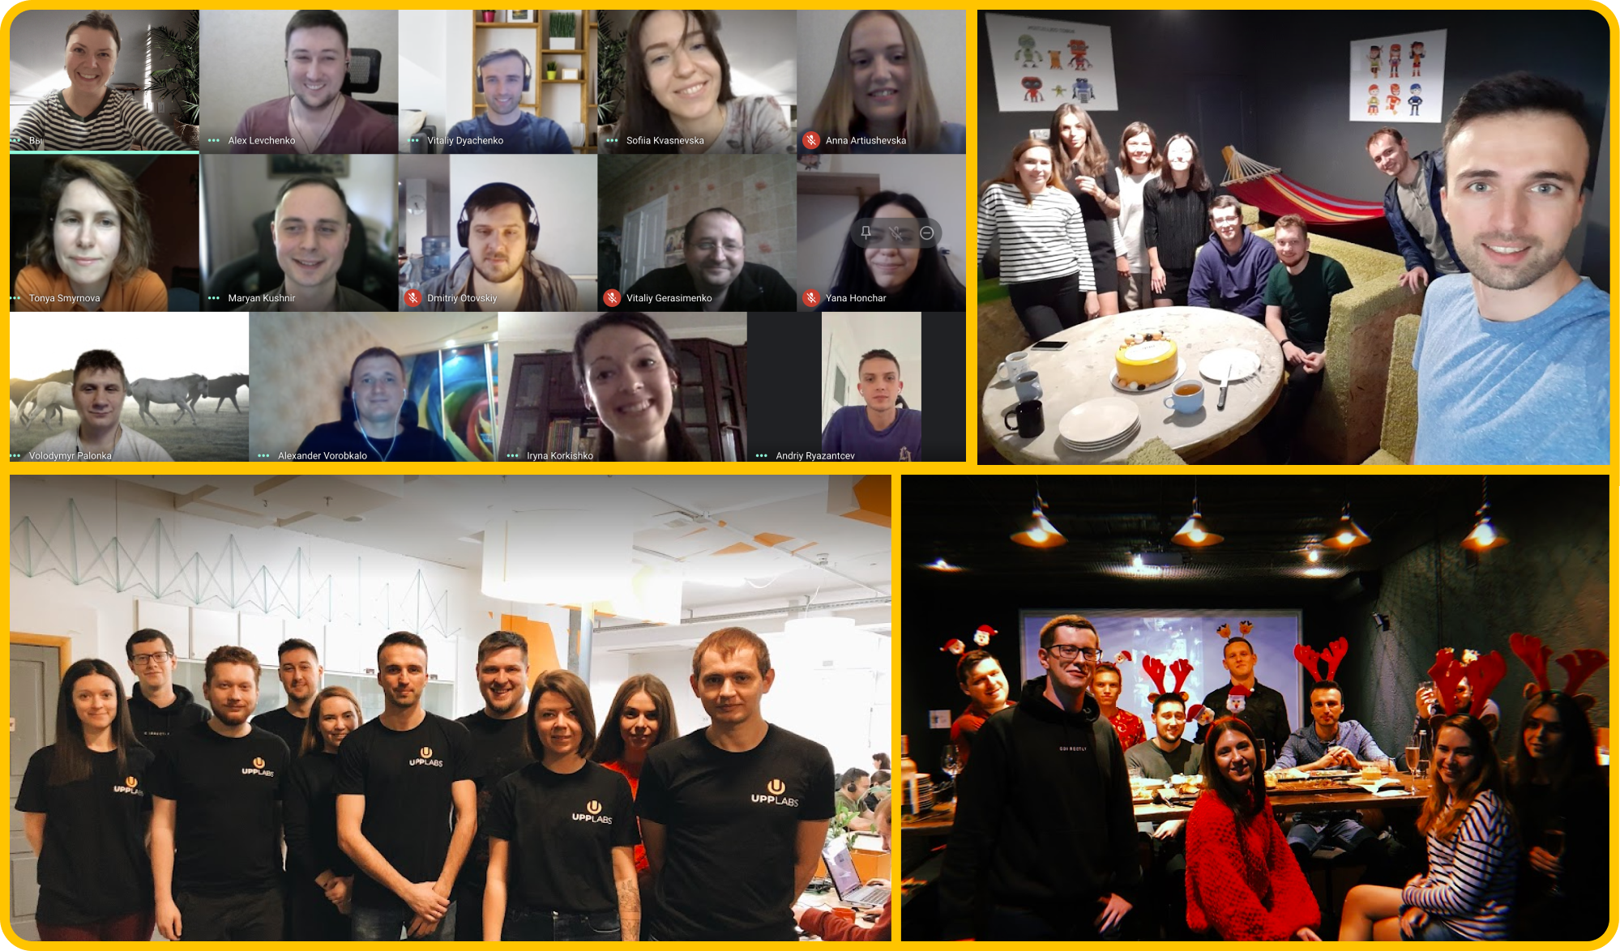
OF UPPLABS
OUR TEAM

Slide 10
THE LIFE OF UPPLABS TEAM
OUR ACTIVITIES
HAPPY HOURS mini team building PET PROJECT a hackathon with no limits in time and resources | MEET THE TEAM small podcast that includes a small interview with someone from our team | CROSS TEAM HELP involving the most experienced professionals to share knowledge with the whole team & company | ALLHANDS sharing company’s stats, results, plans and strategy with the team | ONBOARDING TRAINING new employees training to study the values of the company, its projects, and structure WRITING ARTICLES ASSISTANCE
Notes:
Read more about these activities on oue website https://upplabs.com/blog/best-practices-to-encourage-employees-and-their-effectiveness/
Or on DOU https://dou.ua/lenta/columns/involving-employees-in-company-life/

Slide 11








SELECTED CLIENTS
We have obtained the best practices and expertise from the TOP global companies

Slide 12


THANK YOU FOR YOUR INTEREST
CONTACTS
hr@upplabs.com
natalie.k@upplabs.com
liliia.z@upplabs.com
HR (Anna) +38 063.756.7587

